Slide 1
Session 8-10: Network Devices – Hub, Switch, and Router

Slide 2
Networking devices
Inside a network
Hub: Older device
Switch: Modern device
To connect different networks
Router

Slide 3
Hub
Earlier, hubs were used as connection devices in Ethernet
Hub is a dumb device, works only at the physical layer (Layer 1).
So, it does not know about MAC addresses, and hence floods out all the ports.
Hub operates only in half duplex mode
Attached hosts cannot send and receive data at the same time – they can perform only one of the tasks
All devices in a hub share the same collision domain – If two or more devices transmit at the same time, collisions will occur, leading to CSMA/CD

Slide 4
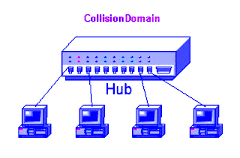
Collision domain concept
All devices that use the same physical media and listen to each frame are considered to be in the same collision domain.
This means that only one device can transmit at any given time, and any other device on the network segment must synchronize with the signal and extract the frame.

Slide 5
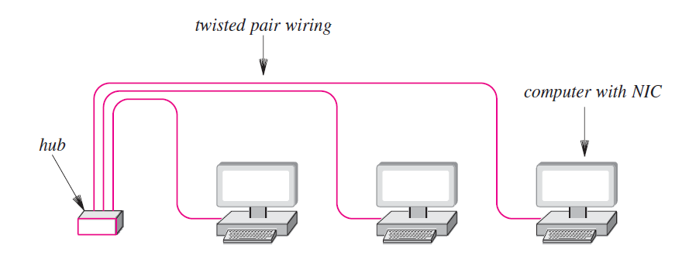
Hub

Slide 6
Switch
Hubs are obsolete
Switch is an intelligent device – can filter traffic
Example
If a hub connects two branches of a network, it will flood both the branches for every received frame
A switch will check whether it should send it to the other branch of the network by comparing addresses, as discussed shortly

Slide 7
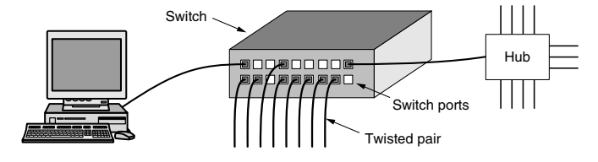
More on Switch
From the outside, a switch looks just like a hub.
They are both boxes, typically with 4 to 48 ports, each with a standard RJ-45 connector for a twisted-pair cable.
If the switch itself fails, it will need to be replaced.

Slide 8
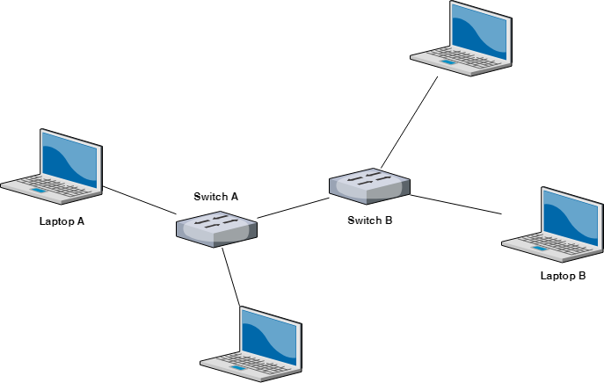
Multiple switches are used these days (Not hubs) …

Slide 9
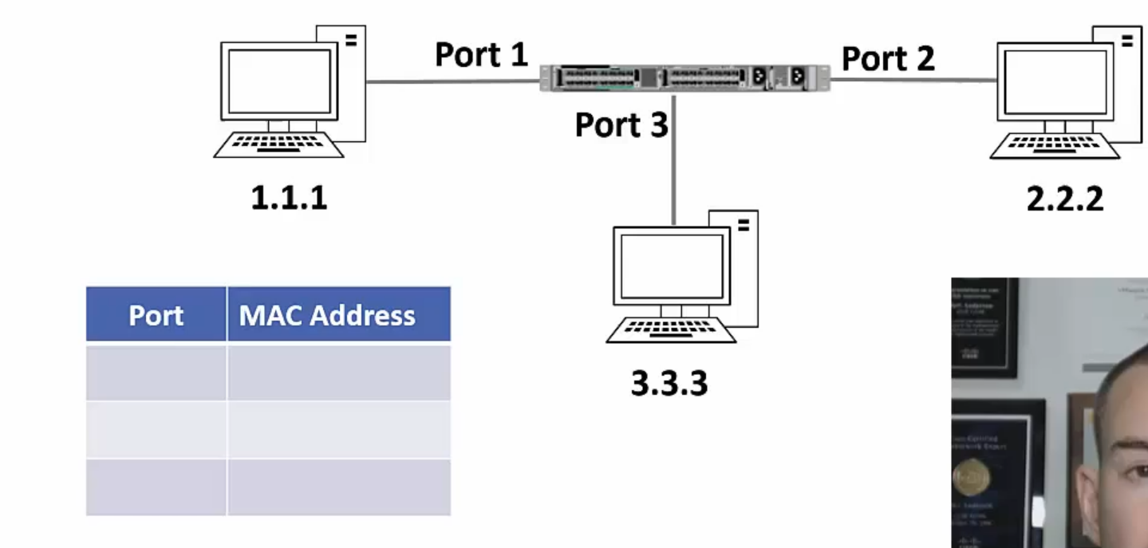
Switching Example – 1
Each switch maintains a mapping table

Slide 10
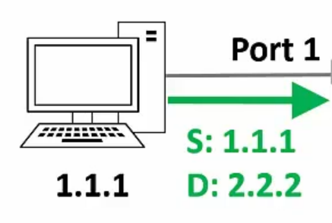
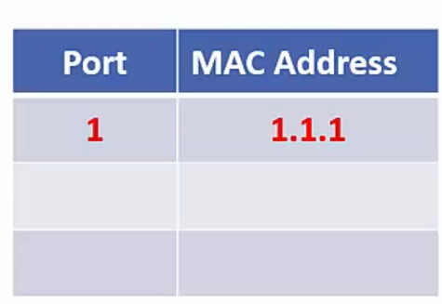
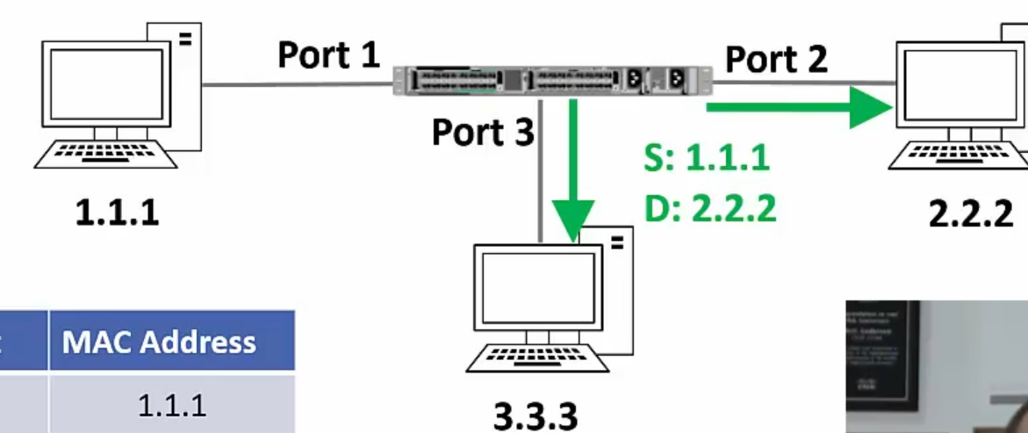
Switching Example – 2
Host 1.1.1 sends a frame to host 2.2.2
Switch sees the frame and updates its mapping table
The switch does not know where 2.2.2 is, so it floods out the frame
`

Slide 11
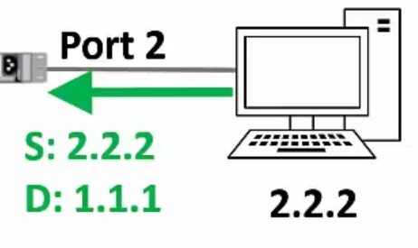
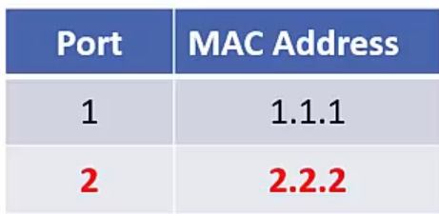
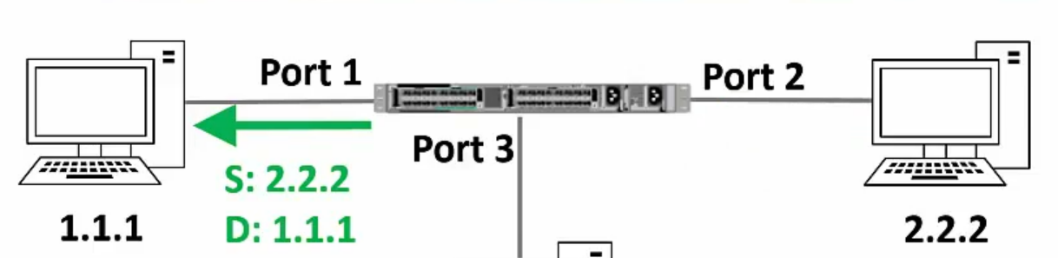
Switching Example – 3
Suppose host 2.2.2 sends a reply to 1.1.1
Switch sees the frame and updates its mapping table
The switch will send the frame only to 1.1.1

Slide 12
“Layer 2” Switch
In OSI, data link layer is layer 2 from the bottom
A switch operates at the data link layer
Hence, sometimes it is also called as Layer 2 switch

Slide 13
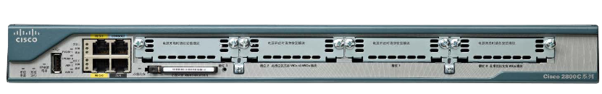
Router
Routers know the paths to get to the different IP subnets on network
They are required to send traffic from one subnet to another
They are also required to send traffic from one network to another
Routers operate at Layer 3 of the OSI model (network layer)

Slide 14
Routers versus Switches
Routers are Layer 3 aware and can route traffic between different networks
Switches are Layer 2 aware and can switch traffic between hosts on the same LAN
Routers support many types of interfaces, such as Ethernet, Serial ISDN, ADSL etc
Switches typically only support Ethernet interfaces
Switches will typically have more ports than routers

Slide 15
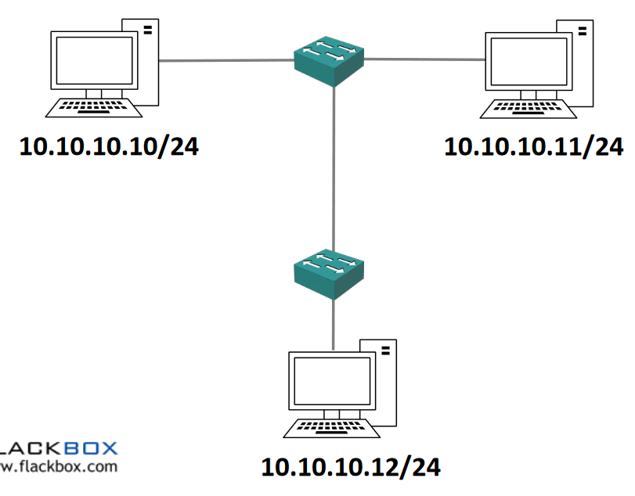
Switch Operation

Slide 16
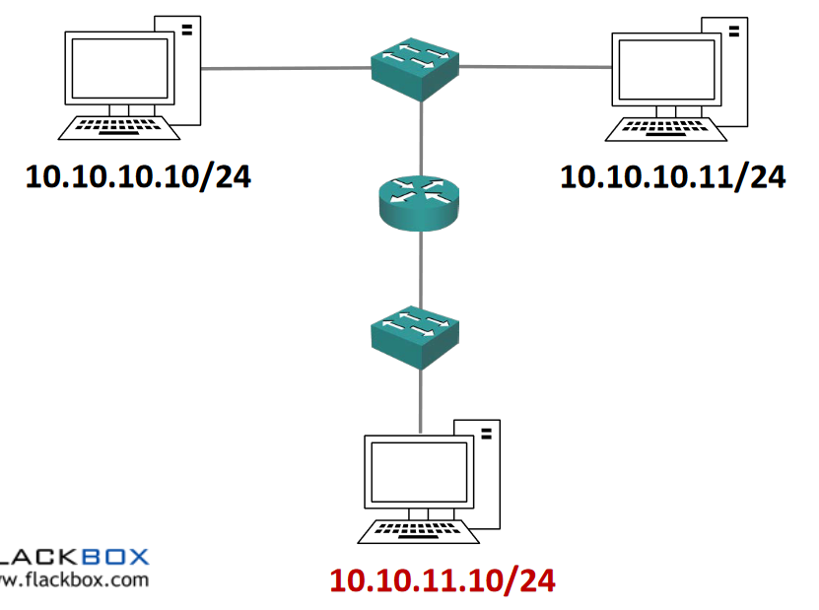
Router Operation

Slide 17

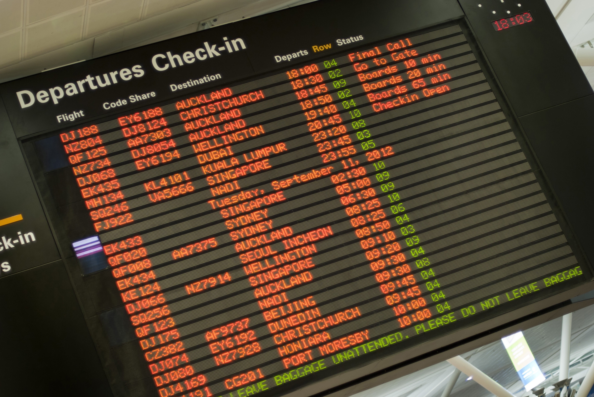
Understanding Routing
Consider a passenger traveling from Pune to Sioux Falls, USA
Pune
Mumbai
San Francisco
Chicago
Sioux Falls
Hop Number | From | To | Passenger’s View
1 | Pune | Mumbai | Pune-Sioux Falls
2 | Mumbai | San Francisco | Pune-Sioux Falls
3 | San Francisco | Chicago | Pune-Sioux Falls
4 | Chicago | Sioux Falls | Pune-Sioux Falls

Slide 18

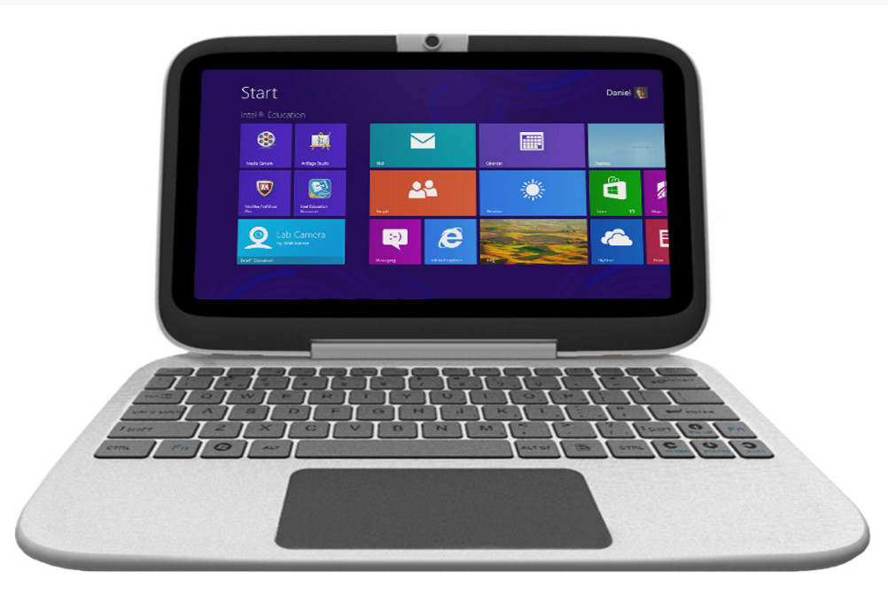

Understanding Routing
Consider a datagram/packet going from computer A to computer B
A
R1
R2
R3
B
 | Data Link Layer | View
Hop Number | From | To | IP View
1 | A | R1 | A-B
2 | R1 | R2 | A-B
3 | R2 | R3 | A-B
4 | R3 | B | A-B

Slide 19
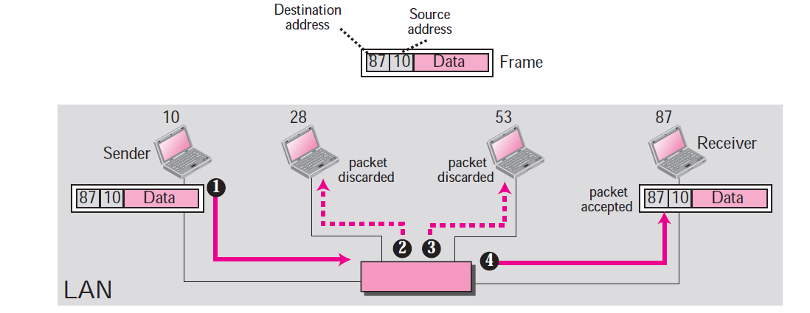
MAC Addresses and LAN

Slide 20
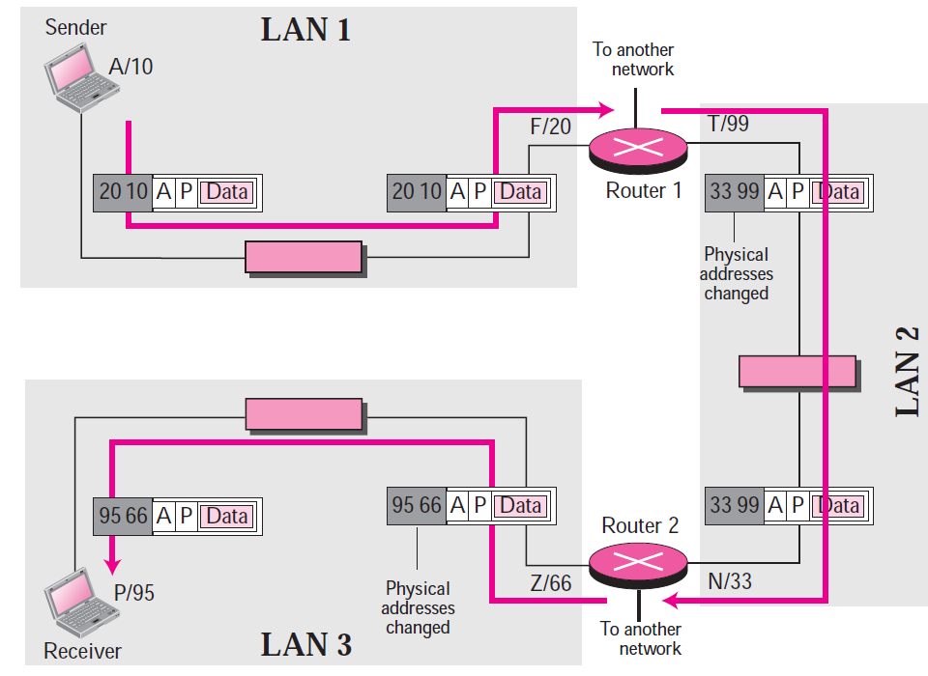
IP Addresses and the Internet

Slide 21
Address Resolution Protocol (ARP)
Takes IP address of a computer as input and finds the MAC address of that computer
Useful to deliver the data to a particular MAC address

Slide 22
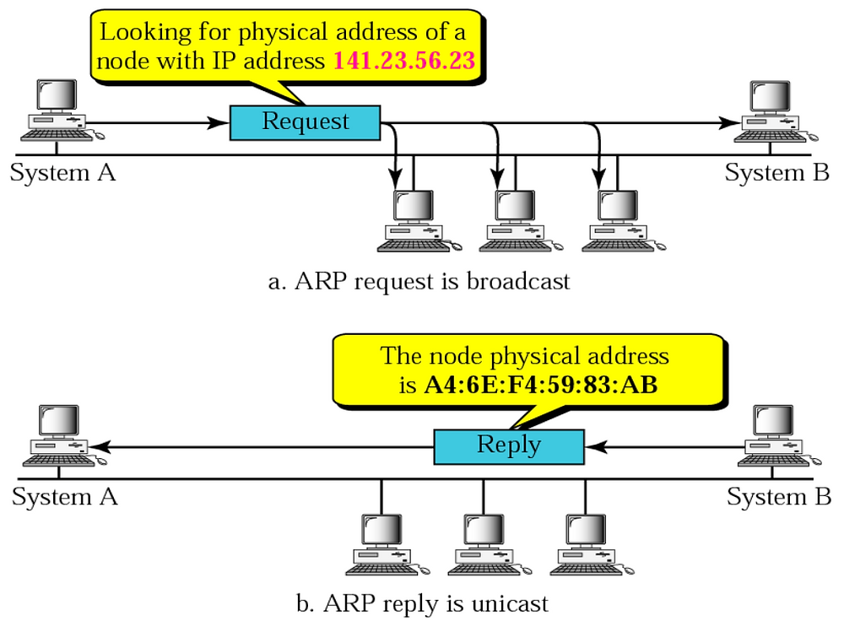
ARP Example

Slide 23
Internet Message Control Protocol (ICMP)
IP is
Connectionless
Unreliable
Unacknowledged
Datagrams are sent over the Internet with no prior connection, no assurance of delivery, and no acknowledgement if they reach the destination successfully
What happens if a router must discard a datagram because it cannot find a router to the final destination, or because the time-to-live field has a zero value?
What happens if the final destination host must discard all fragments of a datagram because it has not received all fragments within a predetermined time limit?
The Internet Control Message Protocol (ICMP) helps IP

Slide 24
ICMP Message Types
Error-reporting messages
Report problems that a router or a host (destination) may encounter when it processes an IP packet
Query messages
Occur in pairs, help a host or a network manager get specific information from a router or another host.
For example, nodes can discover their neighbors.
Also, hosts can discover and learn about routers on their network and routers can help a node redirect its messages.

Slide 25
Subnetting Exercise
For an address 192.168.5.85 /24, we want to create 5 subnets.
What will be the first host address on the first subnet and the second host address on the second subnet?
How many hosts are possible per subnet?

Slide 26
Solution
Our network address is 192.168.5.85 /24.
We want to create 5 subnets. So, 3 bits from the host id portion will be used for the subnet id. So, 5 bits will be left for the host id.
First subnet id in binary will be: 000
First address possible in the first subnet will be: 00000. But this is not the first host address, as this is reserved as the first subnet address.
So, the first host address within the first subnet will be 00001.
The first host address within the first subnet will be:
192.168.5.(000 00001) to the base 2
192.168.5.1 - First host address in the first subnet
The second host address within the second subnet will be:
192.168.5.(001 00010) to the base 2
192.168.5.34
Number of hosts per subnet = 2^{h} – 2 = 2⁵ – 2 = 30

Slide 27
Subnetting Exercise – 3
Consider a class C network with IP address 198.34.5.0.
You are asked to create 6 subnets.

Slide 28
Solution
(1) Write the default mask in decimal.
=> 24 bits are reserved for the network id, 8 bits are reserved for the host id
So, the default mask will be 255.255.255.0
(2) Write the subnet mask in decimal.
=> We want to create 6 subnets. For 6 subnets, we will need to reserve 3 bits for the subnet id (because 2 to the power 3 = 8, which is >= 6)
As we know, the default mask is 255.255.255.0 in decimal
In binary, it will be 11111111.11111111.11111111.00000000
Subnet mask will be: 11111111.11111111.11111111.11100000
Subnet mask in decimal will be: 255.255.255.224
(3) Write the subnetted address for this network.
=> Default network address for this network is 198.34.5.0/24.
Subnetted address for the same network will be 198.34.5.224/27.
(4) What will be the first host address of the first subnet in this network?
=>
There are 6 subnets.
3 bits are reserved for the subnet id.
Subnet ids will be:
First subnet id: 000
Second subnet id: 001
Third subnet id: 010
...
Eigthth subnet id: 111
From above, the first subnet id is 000.
Within this first subnet, the first possible address is 00000
However, the first address is any network or in any subnet is reserved as the network address.
Thus, the first host address will be 00001.
Thus, the full address for the first host in the first subnet will be 00000001 in binary, or 1 in decimal.
And its complete IP address will be 198.34.5.1/27.
(5) How many hosts are possible in the third subnet? What will be the network address for the third subnet, what will be the first host address for the third subnet, and what will be the last host address for the third subnet?

Slide 29
Subnetting Exercise – 4
What are the network address, broadcast address, and valid host addresses for the IP address 198.22.45.173/26?
What is the subnet mask in dotted decimal notation?

Slide 30
Solution
Let’s figure out the subnet mask in dotted decimal notation first because that’s easy...
/26 borrows the first 2 bits in the last octet
128 + 64 = 192
So the subnet mask is 255.255.255.192

Slide 31
Solution - Subnets and Hosts
Our given address is 198.22.45.173/26
Since two bits are reserved for the subnet id, 4 subnets 00, 01, 10, and 11 are possible
We need to think “Our IP address will fall in which of these four subnets?”
To answer this, let us calculate the address range for each of the four subnets

Slide 32
Solution - Subnets and Hosts
Subnet Number (Decimal) | Subnet ID (Binary) | First full address in the subnet (Binary) | Last full address in the subnet (Decimal) | First full address in the subnet (Binary) | Last full address in the subnet (Decimal) | Our target IP address (173)
1 | 00 | 00000000 | 00111111 | 0 | 63 | Not here
2 | 01 | 01000000 | 01111111 | 64 | 127 | Not here
3 | 10 | 10000000 | 10111111 | 128 | 191 | Here
4 | 11 | 11000000 | 11111111 | 192 | 255 | Not here
Our given address is 198.22.45.173/26

Slide 33
Solution
Next let’s calculate the address range for this subnet
The network portion of the address is the first 26 bits
198.22.45.128 is the network address (First address of the third subnet – See the previous slide)
The line is after 64, so add 64 to get the network address of the next subnet
The next subnet begins at 198.22.45.192
So the broadcast address is 198.22.45.191
And the valid host addresses are 198.22.45.129 to 198.22.45.190

Slide 34
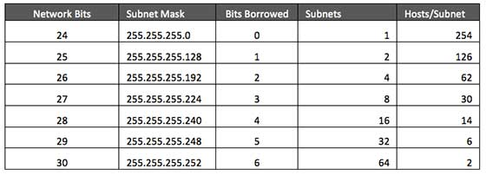
Summary: Subnetting in Class C

